Slide 1

DEALING WITH DIFFICULT PEOPLE
BY
REMY JAYASEKERE

Slide 2


Difficult people
Are people with certain personality traits or emotional characteristics that make it difficult for you to communicate with them.
The ability to effectively cope with such people while maintaining a healthy work environment is known as the skill of dealing with difficult people.

Slide 3
WHO ARE THEY?
TANKS – VIOLENT, ANGRY, BOSSY, EXPLOSIVE, CONTROL FREAKS
BETTER THANS – SHOW OFF, NAME DROP, ONE UP
DOWNERS – NEGATIVE, COMPLAIN
PASSIVES – LOW SELF ESTEEM, DO NOT DO ANYTHING, ONE WORD ANSWRES
THOSE WITH HIDDEN AGENDAS - MANUPULATIVE

Slide 4
WHAT CAN THEY DO TO YOU?
MENTALLY AND PHYSICALLY HARM YOU
CREATE AN UNPLEASANT ENVIRONMENT – ANNOYING OR TOXIC
CREATE STRESS AND NEGATIVITY
DIFFICULT TO COMMUNICATE
AT WORK – RESULTS CAN BE AFFECTED

Slide 5
WHY DO PEOPLE BECOME DIFFICULT?
DIFFICULT BY NATURE
CIRCUMSTANCES AND EXPERIENCES
STRESS
HIDDEN AGENDAS
WRONG PERCEPTIONS

Slide 6
WHAT CAN YOU DO?
RESULT DEPENDS ON HOW YOU REACT
THE MOST DIFFICLUT PERSON COULD BE YOURSELF – THE HARDEST PERSON TO LIVE WITH
MAKE PEACE WITH YOURSELF – YOU WILL NEVER BE LONELY OR DIFFICULT
YOU FIND OTHERS DIFFICULT WHEN YOU ARE DIFFICULT
IF YOU AT PEACE WITH YOURSELF YOU ARE LIKELY TO BE AT PEACE WITH OTHERS

Slide 7
VERBAL COMMUNICATION
WORDS - 7%
TONE AND ATTITUDE – 33%
BODY LANGUAGE – 60%

Slide 8
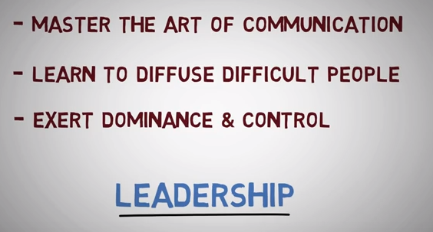

Slide 9
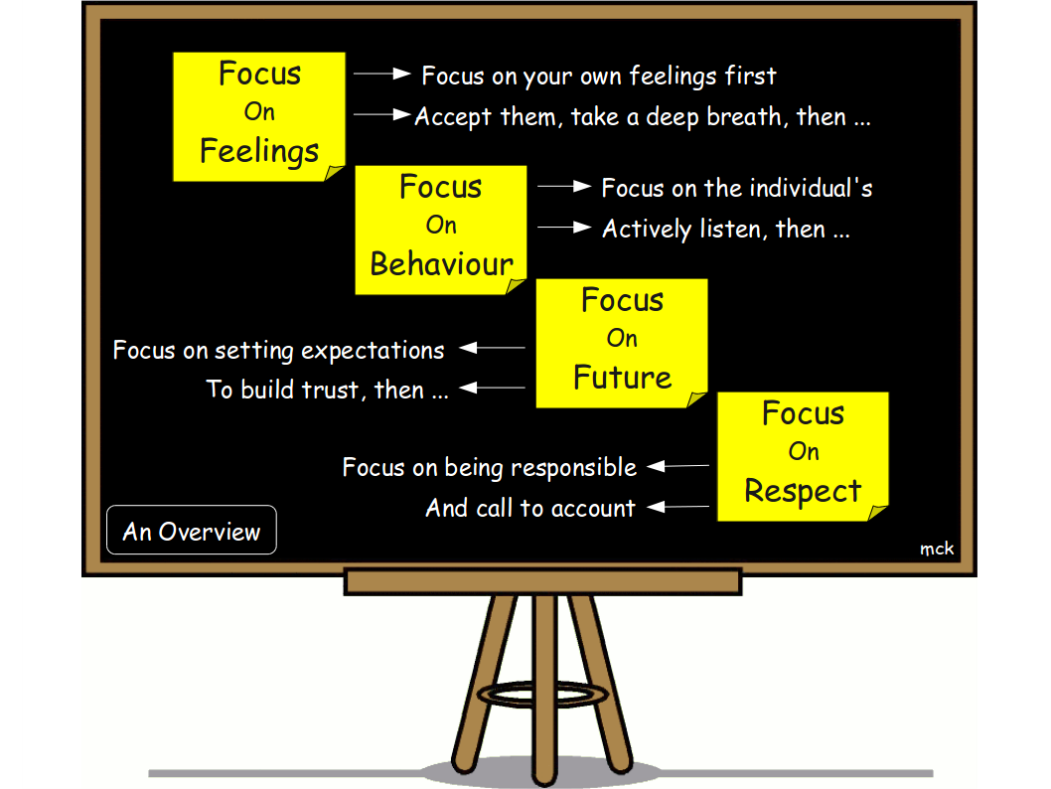

Slide 10
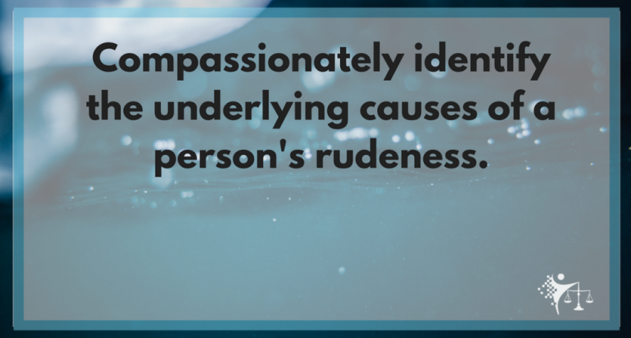

Slide 11
HOW TO DEAL WITH THEM?
Be calm. Losing your temper and flaring out at the other person typically isn't the best way to get him/her to collaborate with you
Understand the person's intentions – What is making this person behave in this manner
Get some perspective from others. In all likelihood, your colleagues, managers and friends must have experienced similar situations in some way or another
Let the person know where you are coming from. Let the person know your intentions behind what you are doing
Build a rapport by connecting with your colleagues on a personal level

Slide 12
HOW TO DEAL WITH THEM? (Continued…..)
6. Treat the person with respect. As the golden rule says, "Do unto others as you would have them do unto you."
7. Focus on what can be actioned upon. What has happened has happened. What can you do to move forward
8. Ignore - If you have already tried everything above and the person is still not being receptive, the best way might be to just ignore
9. Learn and employ effective ways of communication – sandwich your criticism between kind words
9. Escalate to a higher authority for resolution. When all else fails, escalate to your manager. This is considered the trump card and shouldn't be used unless you've completely exhausted your means

Slide 13


Slide 14


